Slide 1

A Platform for Weaving Web 2.0 Features into Web-based Applications
Masterseminar QE
14.01.2013
Supervisor:
Dr. Michael Felderer
In collaboration:
Dr. Dirk Draheim
By:
Viktor Pekar

Slide 2
Agenda
Motivation - What is the problem?
Use Case for “Social Weaving”
Requirements Engineering
Prototype Architecture
Preview

Slide 3
Motivation

Slide 4
Motivation - What is the problem?
Web application (ERP, collaboration platforms like lotus notes, ..) users work in teams
Communication is hard about specific elements in the system or workflows – especially when working remotely.
Idea: Inject social web elements into the web application that allows users to discuss about and interact with it
We will call that “Social Weaving”

Slide 5
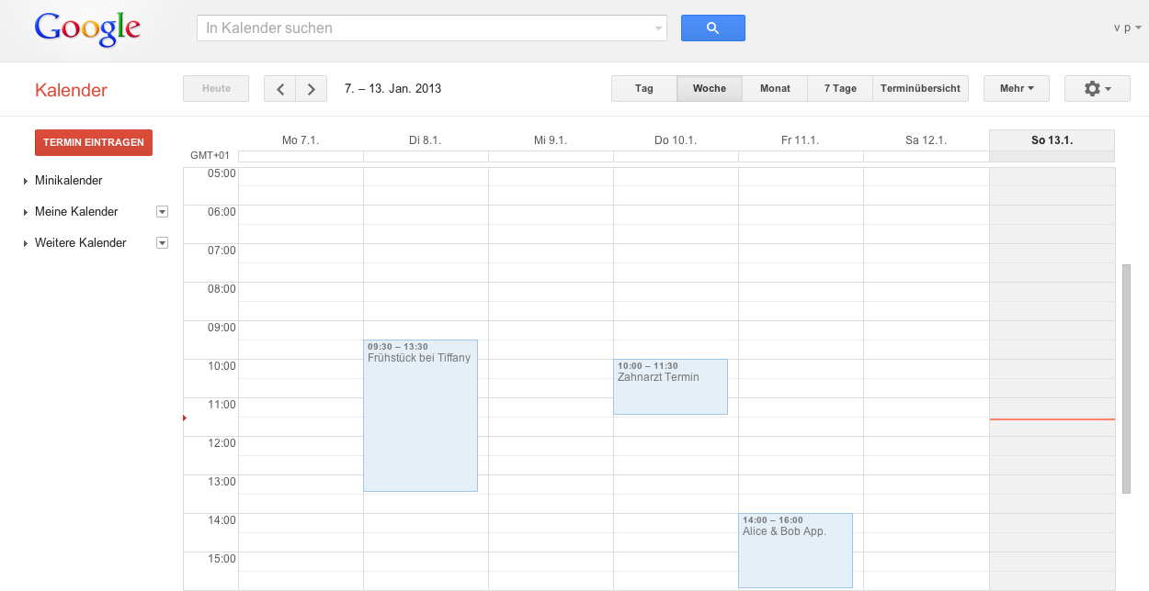
Use Case for “Social Weaving”
Two Google Calendar users, Alice and Bob, use a shared calendar
Alice wants to ask Bob something about their date that is happening Friday night.
instead of calling or texting Bob, Alice uses a social weaving feature and adds a comment box to the appointment
Next time Bob opens his Google Calendar – he sees the comment box attached to the appointment and can answer the question.

Slide 6
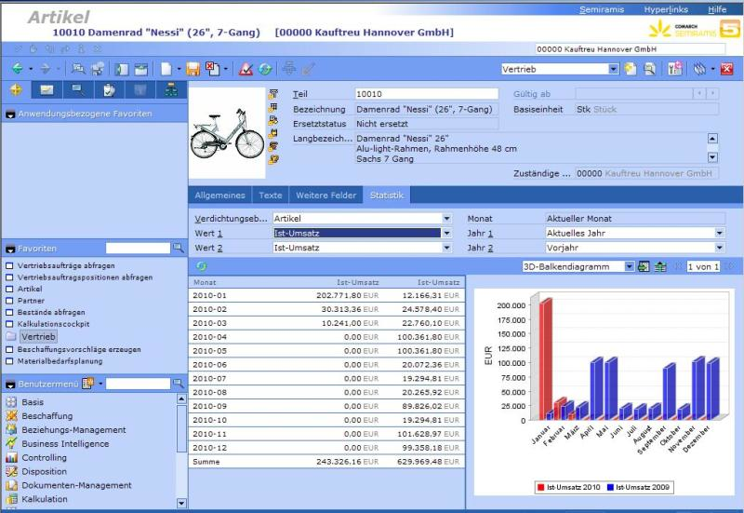
Alice and Bob – Use Case in our context
Social Weaving is way more than just about Google calendar or comment boxes
Ultimate goal is a generic system that can attach many social web elements (like wiki pages, document attachments, comment boxes, chats, …) to any web application, even browser based ERP-systems
More realistic goal (for now) is to proof by concept that this feature is possible to implement

Slide 7
Requirements

Slide 8
Requirements in Detail
Displaying and managing social web content in browser
Server application that synchronizes views
Communication to server application
Identifying web elements across different user sessions

Slide 9
Displaying and managing Social Web Content in Browser
A client (most likely a browser plugin) has to be able to
draw content to users view
read new input content from user
communicate with server

Slide 10
Server application that synchronizes views
A server based service needs to be able to synchronize different views from different clients
Server should have no knowledge about anything on the client side (like web application, browser, …)

Slide 11
Communication to server application
the communication between server and clients needs to be a uniform protocol that might be used with different clients and different web applications

Slide 12
Identifying web elements across different user sessions
most challenging part in social weaving
unique identification along different user sessions depends highly on the web application
a generic solution is probably not possible
an extensible framework should provide web application specific functionality so that users can write their own scripts to support an new web application

Slide 13

Introducing Social Weaver
Social Weaver (Philetairus socius) is a species of bird in the Passeridae family endemic to Southern Africa

Slide 14
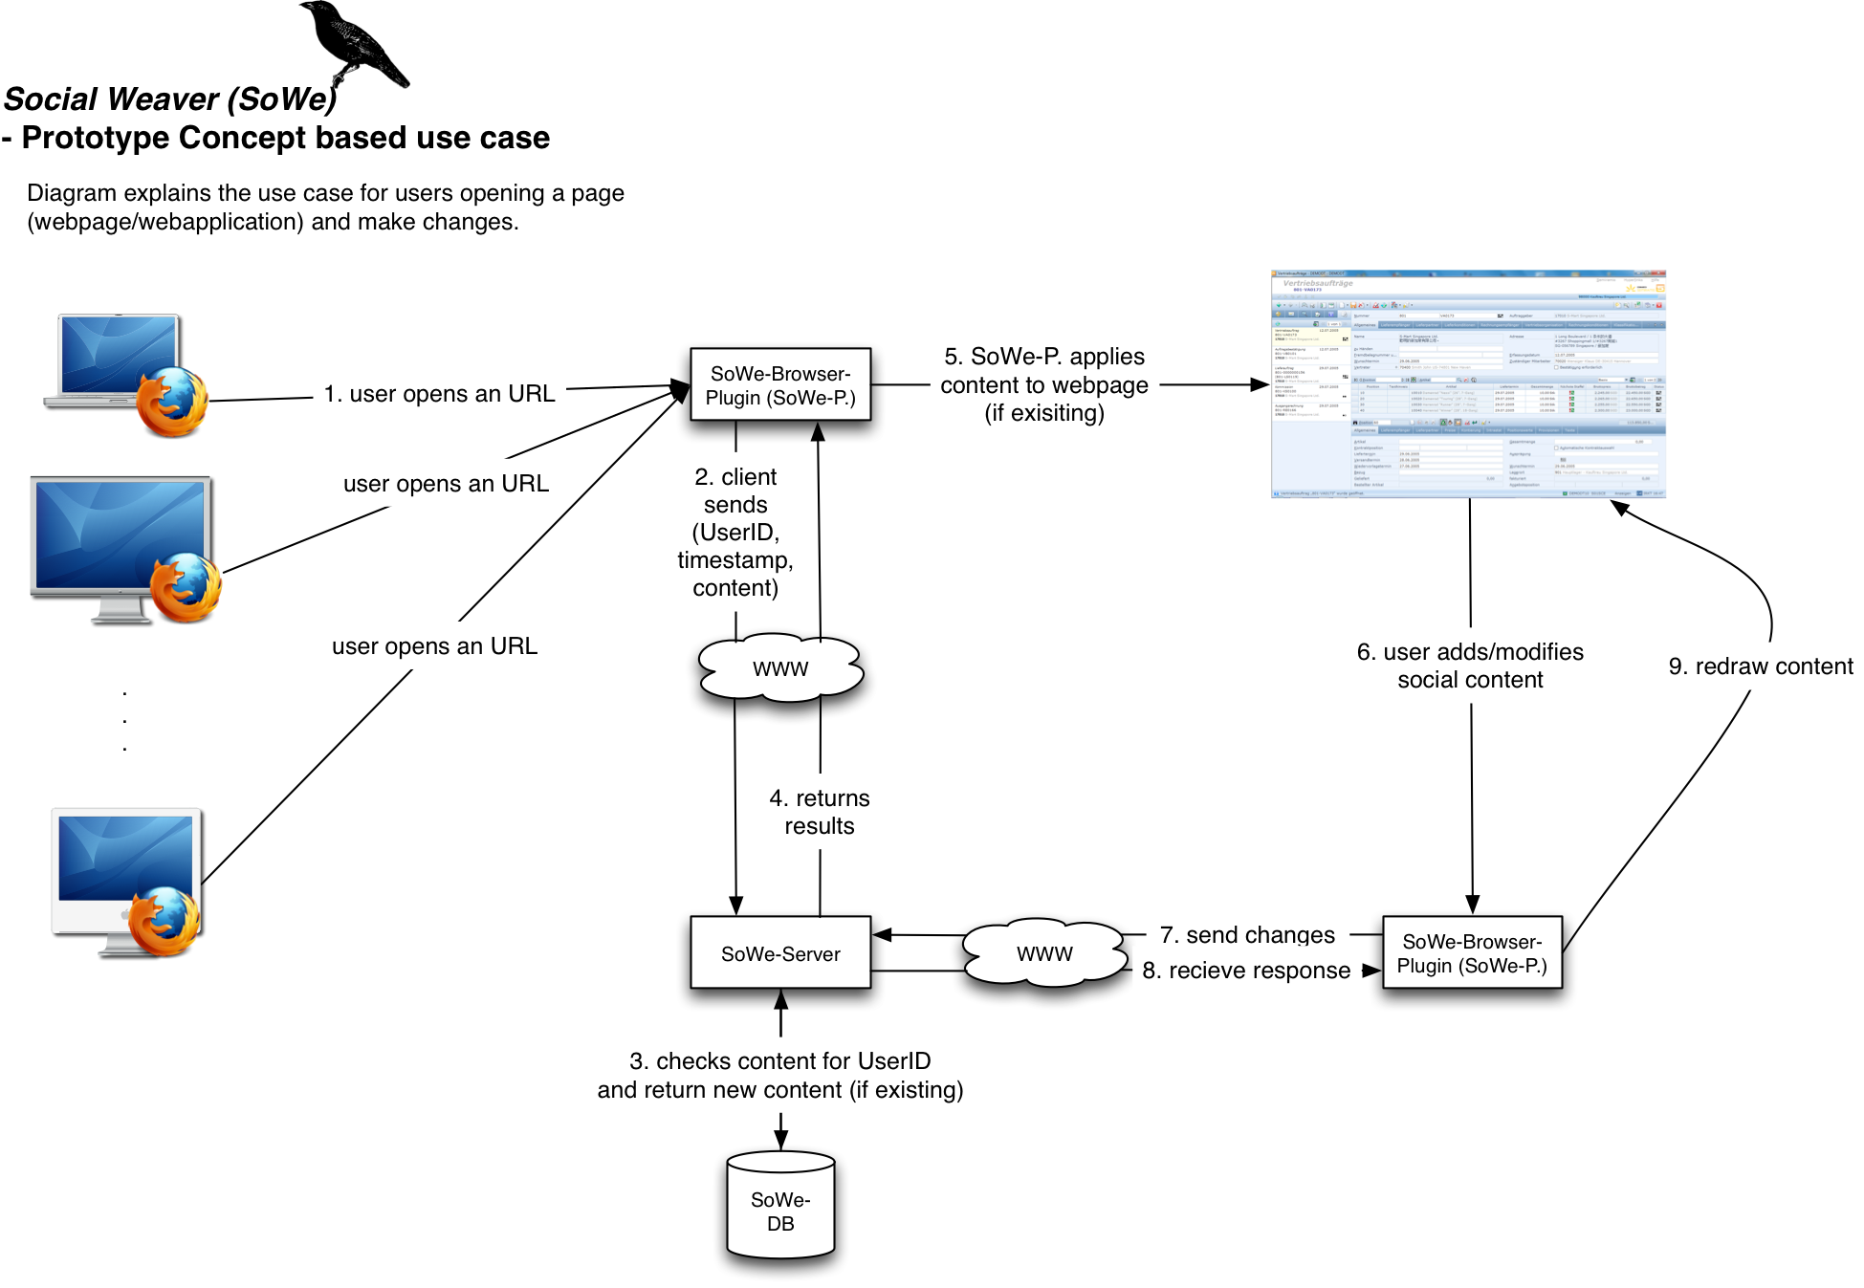

Slide 15
Step-By-Step Example using the new Requirements
An user opens an URL
The Browser-Plugin (Client) send a triplet to our web service (Server) [UserId, Timestamp, Content]
The server checks if there is any existing content for this URL
The server returns already existing content back to the client
The client displays the received content (if any) in the browser
The user may modify or add social content

Slide 16
Step-By-Step Example using the new Requirements
Client sends new or modified data to the server
Server answers with a synchronized response (in case other users modified content in between)
Client redraws new content

Slide 17
Some more Details about Social Weaver Innards

Slide 18
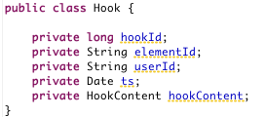
How to hook web elements into web applications? About Hooks
Hooks are hooking to an explicit element in a web application
uniform and generic way to express and hold information

Slide 19
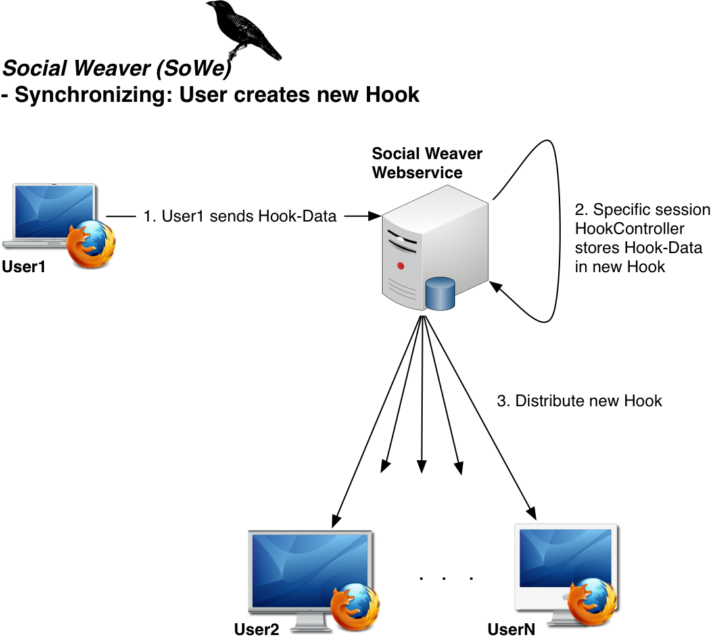

Slide 20
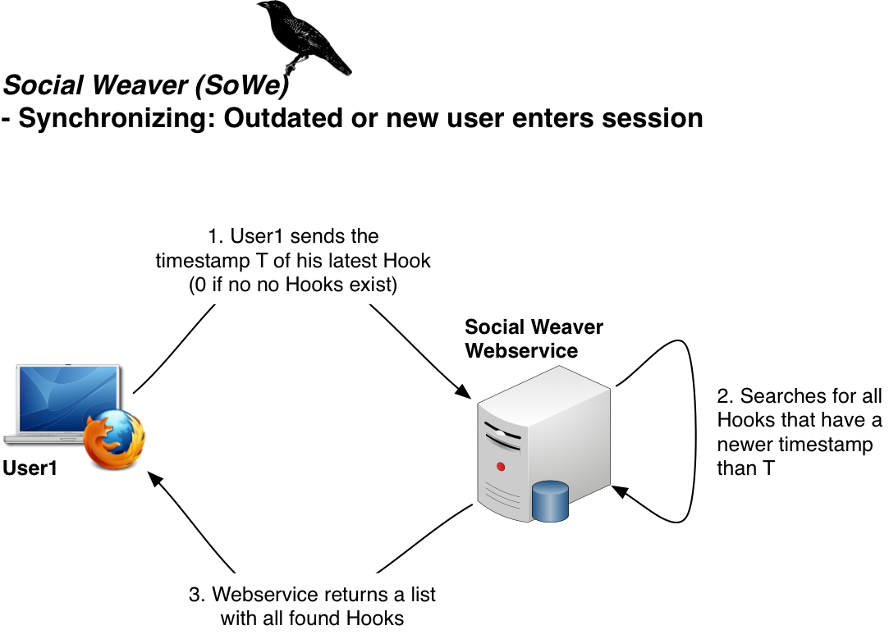

Slide 21
Communication between server and client

Slide 22
RESTCompanion
flexible and extensible framework for REST communication to a web service
no direct relation to Social Weaver – but developed because of the needs of Social Weaver
supports En/Decryption of messages (independent of secure connections (e.g. SSL, TLS)
Social Weaver uses RESTCompanion for communication between server and client

Slide 23

RESTCompanion (cont.)
RESTCompanion uses Parcels
A parcel is a tuple consisting of a type code and the actual message (that might be encrypted)
Type code is used to determine
if message is encrypted
if message needs write access

Slide 24
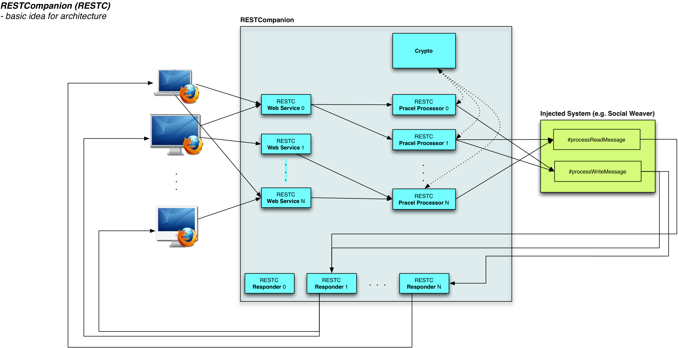

Slide 25
Will Social Weaver be useful for me and my friends? (Private Usage)
primary goal of Social Weaver are web apps used in enterprises
but basically it can be used for any web application and HTML sites
possible use cases for private usage:
students might discuss a webpage directly on it
friends can privately comment on a product on amazon to decide whether it is worth it or not
…
anything that runs in a browser is usable

Slide 26
Thanks for your attention ☺

